Slide 1
SOLID in Ruby

Slide 2
How do you recognize a good design?

Slide 3

Notes:
In the 90’s
C++ and Java, statically typed languages

Slide 4
Single Responsibility Principle
Open/Closed Principle
Liskov Substitution Principle
Interface Segregation Principle
Dependency Inversion Principle

Slide 5
Single Responsibility Principle
Open/Closed Principle
Liskov Substitution Principle
Interface Segregation Principle
Dependency Inversion Principle

Slide 6
http://butunclebob.com/ArticleS.UncleBob.PrinciplesOfOod

Slide 7
A class should have one, and only one, reason to change.
Single Responsiblity Principle

Slide 8
class User < ActiveRecord::Base include SynchronizableModel include DomainSupport include PermissiveNestedAttributes extend Asynchronizable extend Sunspot::Rails::Searchable::ClassMethods
CSS_POSITION_CATEGORY = "CSS"
ACTIVE = 'Active'
ALUMNI = 'Alumni'
EDUCATION = 'Education'
EXTERNAL = 'External'
ATTRIBUTES_TO_IGNORE = [
:updated_at,
:last_request_at,
:crypted_password,
:salt,
:login_count,
:failed_login_count,
:login_count,
:vendor_person_id,
:last_login_id,
:consented,
:first_time,
:avatar_file_name,
:avatar_content_type,
:avatar_file_size,
:avatar_updated_at
] default_scope :order => "last_name, first_name" concerned_with #from less monkey patchin has_many :interviews attr_accessor :password_confirmation, :old_password, :password_being_reset, :abuse_unit attr_writer :indexing_enabled attr_protected :password, :password_confirmation, :salt has_attached_file :avatar, :default_url => "/images/default_:style_avatar.jpg",
:styles => {:alumni_thumbnail => "27x36", :alumni_photo => "105x140", :thumb => "100>"} validates_attachment_size(:avatar, :less_than => 1.megabyte)

Slide 9
has_many :interviews attr_accessor :password_confirmation, :old_password, :password_being_reset, :abuse_unit attr_writer :indexing_enabled attr_protected :password, :password_confirmation, :salt has_attached_file :avatar, :default_url => "/images/default_:style_avatar.jpg",
:styles => {:alumni_thumbnail => "27x36", :alumni_photo => "105x140", :thumb => "100>"} validates_attachment_size(:avatar, :less_than => 1.megabyte) has_one :home_address, :class_name => 'Address', :conditions => {:address_type => Address::HOME}, :dependent => :destroy, :autosave => true has_one :business_address, :class_name => 'Address', :conditions => {:address_type => Address::BUSINESS}, :dependent => :destroy, :autosave => true has_one :preferred_address, :class_name => 'Address', :conditions => {:address_type => [Address::HOME, Address::BUSINESS], :preferred => true} has_one :home_email, :class_name => 'Email', :conditions => {:email_type => Email::Type::PERSONAL}, :dependent => :delete, :autosave => true has_one :business_email, :class_name => 'Email', :conditions => {:email_type => Email::Type::BUSINESS}, :dependent => :delete, :autosave => true has_one :preferred_email, :class_name => 'Email', :conditions => {:email_type => [Email::Type::PERSONAL, Email::Type::BUSINESS], :preferred => true} has_one :current_work_experience, :conditions => {:end_date => nil}, :class_name => WorkExperience.name has_one :can, :class_name => 'Permission' has_many :searches has_many :activities, :dependent => :destroy has_many :emails, :extend => RemoteForeignKey, :dependent => :destroy, :autosave => true has_many :addresses, :extend => RemoteForeignKey, :dependent => :destroy, :autosave => true has_many :phones, :extend => RemoteForeignKey, :dependent => :destroy, :autosave => true has_many :board_memberships, :extend => RemoteForeignKey, :dependent => :destroy, :autosave => true has_many :work_experiences, :extend => RemoteForeignKey, :dependent => :destroy, :autosave => true, :order => "(end_date IS NULL) DESC, end_date DESC, start_date DESC" has_many :educations, :extend => RemoteForeignKey, :dependent => :destroy, :autosave => true, :order => 'end_year DESC, start_year DESC' has_many :leaves, :dependent => :destroy, :autosave => true has_many :promotions, :dependent => :destroy, :autosave => true, :order => 'start_date ASC' has_many :offices, :dependent => :destroy, :autosave => true, :order => 'start_date DESC' do def uniq reject { |o| self[0, index(o)].map(&:name).include? o.name } end end has_many :interviews attr_accessor :password_confirmation, :old_password, :password_being_reset, :abuse_unit attr_writer :indexing_enabled attr_protected :password, :password_confirmation, :salt has_attached_file :avatar, :default_url => "/images/default_:style_avatar.jpg",
:styles => {:alumni_thumbnail => "27x36", :alumni_photo => "105x140", :thumb => "100>"} validates_attachment_size(:avatar, :less_than => 1.megabyte)

Slide 10
has_many :leaves, :dependent => :destroy, :autosave => true has_many :promotions, :dependent => :destroy, :autosave => true, :order => 'start_date ASC' has_many :offices, :dependent => :destroy, :autosave => true, :order => 'start_date DESC' do def uniq reject { |o| self[0, index(o)].map(&:name).include? o.name } end end has_many :personal_phones, :conditions => ["phone_type in (?)", Phone::Type::PERSONAL], :class_name => 'Phone' has_many :business_phones, :conditions => ["phone_type in (?)", Phone::Type::BUSINESS], :class_name => 'Phone' has_many :sent_messages, :class_name=>'Message', :foreign_key=>'author_id', :uniq => true, :conditions=>"recipient_id is null" has_many :received_messages, :class_name=>'Message', :foreign_key=>'recipient_id', :uniq => true has_many :friendships, :foreign_key => :inviter_id has_many :friends,
:through => :friendships,
:source => :invited,
:conditions => "friendships.status = #{Friendship::ACCEPTED} AND archived_at is null AND archive_number is null AND deny_login = false" has_many :user_views accepts_nested_attributes_for :home_address, :business_address, :phones, :emails, :educations, :work_experiences, :board_memberships, :allow_destroy => true after_update :monitor_attributes after_save :potential_index after_destroy :remove_from_index! before_save :strip_name_and_login_id! after_create :create_permissions_record # after_save :clear_password has_many :interviews attr_accessor :password_confirmation, :old_password, :password_being_reset, :abuse_unit attr_writer :indexing_enabled attr_protected :password, :password_confirmation, :salt has_attached_file :avatar, :default_url => "/images/default_:style_avatar.jpg",
:styles => {:alumni_thumbnail => "27x36", :alumni_photo => "105x140", :thumb => "100>"} validates_attachment_size(:avatar, :less_than => 1.megabyte)

Slide 11
validates_confirmation_of :password, :message => 'Passwords provided do not match.', :if => :setting_password validates_presence_of :first_name, :last_name, :message => "is a required field" validates_presence_of :fmno validates_uniqueness_of :fmno validates_length_of :first_name, :last_name, :maximum => 35, :allow_nil => true validates_length_of :login_id, :maximum => 50, :allow_nil => true
# TODO we can probably improve password validation. The process for resetting
# or changing a password involves many variables and could probably be
# more straightforward. DH 7/5/10 validate :validate_password_strength, :validate_old_password track_activity_of :self, :only => :update, :only_attr => [:first_name, :last_name, :preferred_name, :deceased_flag, :position_category, :personal_achievements, :personal_interests, :professional_achievements, :family_information] track_activity_of :self, :only => :update, :as => :status, :only_attr => :status acts_as_authentic do |c| c.login_field :login_id c.validate_login_field false c.validate_password_field false #don't use authlogic password validation c.check_passwords_against_database true c.crypto_provider Authlogic::CryptoProviders::Sha1 c.logged_in_timeout 20.minutes end
.........

Slide 12
Goes on for over 500 more lines

Slide 13
Does anyone see a pattern?

Slide 14
Separation of Concerns

Slide 15
Authentication
Roles
State
Search
Auditing
...

Slide 16
Solution?

Slide 17
Mixins

Slide 18
New User Model class User < ActiveRecord::Base include Authentication include Authentication::ByPassword include Authentication::ByLDAP include User::States include Project::Search include Project::Mailer include Project::Replication
... end

Slide 19
AND / OR

Slide 20
You should be able to extend a class’s behavior, without modifying it.
Open/Closed Principle

Slide 21
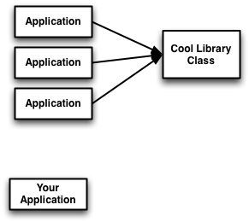

Slide 22
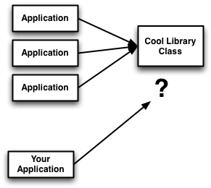

Slide 23
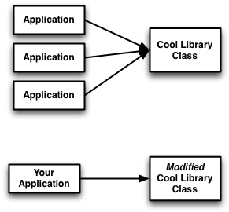

Slide 24
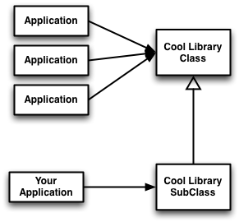

Slide 25
Open Classes?

Slide 26
Maybe

Slide 27
simple_logger.rb
class SimpleLogger attr_accessor :format_string
def initialize @format_string = "%s: %s\n" end
def log(msg) STDOUT.write(format(Time.now, msg)) end
def format(time, msg) @format_string % [ time.strftime('%Y-%m-%d %H:%M:%S'), msg] endend
Notes:
real life example

Slide 28
simple_logger.rb
class SimpleLogger attr_accessor :format_string
def initialize @format_string = "%s: %s\n" end
def log(msg) STDOUT.write(format(Time.now, msg)) end
def format(time, msg) @format_string % [ time.strftime('%Y-%m-%d %H:%M:%S'), msg] endend
User Control over Formatting

Slide 29
app.rb
require 'simple_logger'logger = SimpleLogger.newlogger.format_string = "LOG: %s: %s\n"logger.log("Hello, World")
Console:
$ ruby app.rbLOG: 2009-08-06 14:56:46: Hello, World

Slide 30
app.rb
require 'simple_logger'require 'cool_library'logger = SimpleLogger.newlogger.format_string = "LOG: %s: %s\n"logger.log("Hello, World")
Console:
$ ruby app.rb06/08/09 15:14:22: Hello, World
What happened to our formatting?

Slide 31
cool_library.rb
# Open logger to fix itclass SimpleLogger def format(time, msg) "#{time.strftime("%d/%m/%y %H:%M:%S")}: " + #{msg}\n" endendclass CoolLibrary # blah blah blahend
Library redefines format method!

Slide 32
Principle Of Least Surprise

Slide 33
Better Way?

Slide 34
cool_library.rb
class CoolLogger < SimpleLogger def format(time, msg) "#{time.strftime("%d/%m/%y %H:%M:%S")}: " + "#{msg}\n" endendclass CoolLibrary # blah blah blahend

Slide 35
Prefer Subclassing or Wrapping over Reopening classes

Slide 36
Depend on abstractions, not on concretions.
Dependency Inversion Principle
Notes:
I’d like to move up D in SOLID, because we need some terms explained here later

Slide 37
The Thermostat Problem

Slide 38


Slide 39
Furnace.java
class Furnace { public Furnace() { off(); } public void on() { // Code to turn furnace on. } public void off() { // Code to turn furnace off. }}

Slide 40
Thermostat.java
class Thermostat { public Thermostat(Furnace f) { this.furnace = f; } public void run() { if (should_be_on()) { this.furnace.on(); } else { this.furnace.off(); } } private Furnace furnace; //...}
Explicit references
to Furnace

Slide 42


Slide 43
OnOffDevice.java
interface OnOffDevice { public void on(); public void off();}
Thermostat.java
class Thermostat { public Thermostat(OnOffDevice f) { this.furnace = f; } // ... private OnOffDevice furnace; //...}

Slide 45
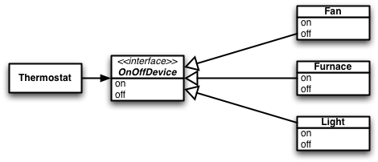

Slide 46
Code to Interfaces

Slide 47
How about Ruby?

Slide 48
Furnace.rb
class Furnace def initialize off end def on # Code to turn furnace on end def off # Code to turn furnace off endend

Slide 49
Thermostat.rb -- Pre-DIP
class Thermostat def initialize(furnace) @furnace = furnace end def run if should_be_on? @furnace.on else @furnace.off end end # ...end

Slide 50
Thermostat.rb -- Post-DIP
class Thermostat def initialize(furnace) @furnace = furnace end def run if should_be_on? @furnace.on else @furnace.off end end # ...end

Slide 51
Thermostat.rb -- Post-DIP
class Thermostat def initialize(device) @device = device end def run if should_be_on? @device.on else @device.off end end # ...end

Slide 52
(an aside)
Thermostat.rb
class Thermostat def initialize(furnace)
fail “Must use a Furnace” unless
furnace.is_a?(Furnace) @furnace = furnace end def run if should_be_on? @furnace.on else @furnace.off end end # ...end
Explicit references
to Furnace

Slide 53


Slide 54


Slide 55
Protocols are Important

Slide 56
(another aside)
Thermostat.rb
class Thermostat def initialize(furnace)
fail “Must use a On/Off Device” unless
[:on, :off].all?{|m| furnace.respond_to?(m)} @furnace = furnace end def run if should_be_on? @furnace.on else @furnace.off end end # ...end
No Explicit Reference,
but not much better

Slide 57
Code to Protocols

Slide 58
Derived classes must be substitutable for their base classes.
Liskov Substitution Principle
-- Robert Martin

Slide 59
Duck Typing
Liskov Substitution Principle
(If it walks like a duck ... etc.)
-- Dave Thomas
Notes:
C++, Java - inheritance
Ruby - Duck Typing

Slide 60
When is something... substitutable?

Slide 61
class NormalMath
def sqrt(x)
guess = 1.0
while (x - guess*guess).abs > 0.001
guess = (guess + (x/guess)) / 2.0
end
guess
end
end

Slide 62
Substitutable?
class AccurateMath
def sqrt(x)
guess = 1.0
while (x - guess*guess).abs > 0.00001
guess = (guess + (x/guess)) / 2.0
end
guess
end
end

Slide 63
How about this one?
class SloppyMath
def sqrt(x)
guess = 1.0
while (x - guess*guess).abs > 0.1
guess = (guess + (x/guess)) / 2.0
end
guess
end
end

Slide 64
Two Questions
What does the method require?
What does the method promise?
def sqrt(x)
requires
?
promises
?

Slide 65
Two Questions
What does the method require?
What does the method promise?
def sqrt(x)
requires
non_negative: x >= 0
promises
?

Slide 66
Two Questions
What does the method require?
What does the method promise?
def sqrt(x)
requires
non_negative: x >= 0
promises
accurate: (x - result**2).abs <= 0.001

Slide 67
Client Software
# Distance between points a and b
def distance(a, b, math)
math.sqrt(
(a.x - b.x)**2 +
(a.y - b.y)**2)
end

Slide 68
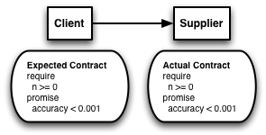
Same Contract - OK

Slide 69
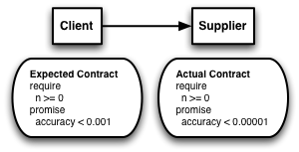
Better Promise - OK

Slide 70
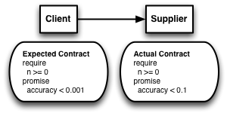
Worse Promise - FAIL

Slide 71
How about this one?
class ComplexSquare def root(x) guess = (x < 0) ? Complex(0, 1) : 1.0 while (x - guess*guess).abs > 0.001 guess = (guess + (x/guess)) / 2.0 end guess endend

Slide 72
How about this one?
class ComplexSquare def root(x) guess = (x < 0) ? Complex(0, 1) : 1.0 while (x - guess*guess).abs > 0.001 guess = (guess + (x/guess)) / 2.0 end guess endend
No Assumptions about x >= 0

Slide 73
How about this one?
class ComplexSquare def root(x) guess = (x < 0) ? Complex(0, 1) : 1.0 while (x - guess*guess).abs > 0.001 guess = (guess + (x/guess)) / 2.0 end guess endend
Same Accuracy Guarantee!

Slide 74
Complex Math Contract
No requirements on the value of x
  Equivalent to a TRUE condition
def sqrt(x)
requires
anything: true
promises
accurate: (x - result**2).abs <= 0.001

Slide 75
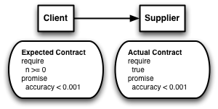
Less Restrictive Requirement - OK

Slide 76

More Restrictive Requirement - FAIL

Slide 77
When is something... substitutable?

Slide 78
Require No More
Promise No Less

Slide 79
Make fine grained interfaces that are client specific.
Interface Segregation Principle

Slide 80

Wildcard Keyboard/Display

Slide 81
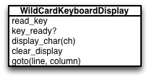

Slide 82
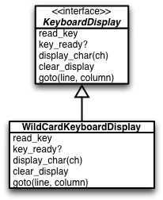

Slide 83
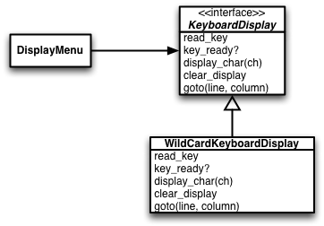

Slide 84
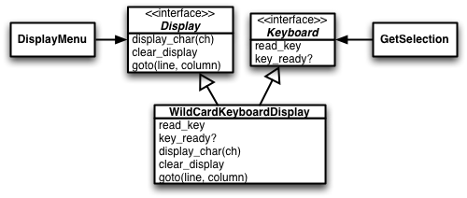
Fine grained interfaces

Slide 85
Why?

Slide 86
(1)
Client software depends on less
(and therefore have fewer reasons to change)

Slide 87
Only needs to change
if Display changes
Only needs to change
if Keyboad changes

Slide 88
(2)
Easier to implement alternative solutions

Slide 89
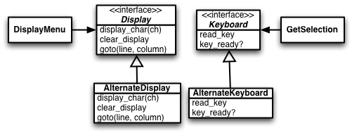
No need to implement
unneeded methods

Slide 90
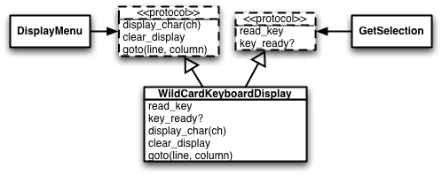
ISP with Protocols?

Slide 91
Clients should depend on as narrow protocol as possible.
Interface Segregation Principle

Slide 92
e.g.
If you are using an array as a stack ... only use the push/pop methods

Slide 93
For Discussion ...

Slide 94
ActiveRecord objects implement a domain concept and a persistence concept. Does this violate SRP?
For Discussion
Notes:
AR 2.0 maybe yes
AR 3.0 better
but they all use modules to separate concerns, all modules single responsibility

Slide 95
How do you verify that your client software only uses the (narrow) protocol you expect?
For Discussion
Notes:
Proxy objects
Throw exceptions, but that’s overkill
documentation, deprecation messages

Slide 96
Summary

Slide 97
SOLID Principles are important for understanding good OO design

Slide 98
Although developed with static languages in mind ...

Slide 99
... Useful lessons can still be applied to dynamic languages (like Ruby)

Slide 100
Thank - You

Slide 101
References

Slide 102
References
More on SOLID can be found at:
  http://butunclebob.com/ArticleS.UncleBob.PrinciplesOfOod
  http://www.lostechies.com/content/pablo_ebook.aspx
  http://www.globalnerdy.com/2009/07/31/barbara-liskov-interviewed/ (interview with Barbara Liskov)
  http://github.com/jimweirich/presentation_solid_ruby

Slide 103

License

